Slide 1
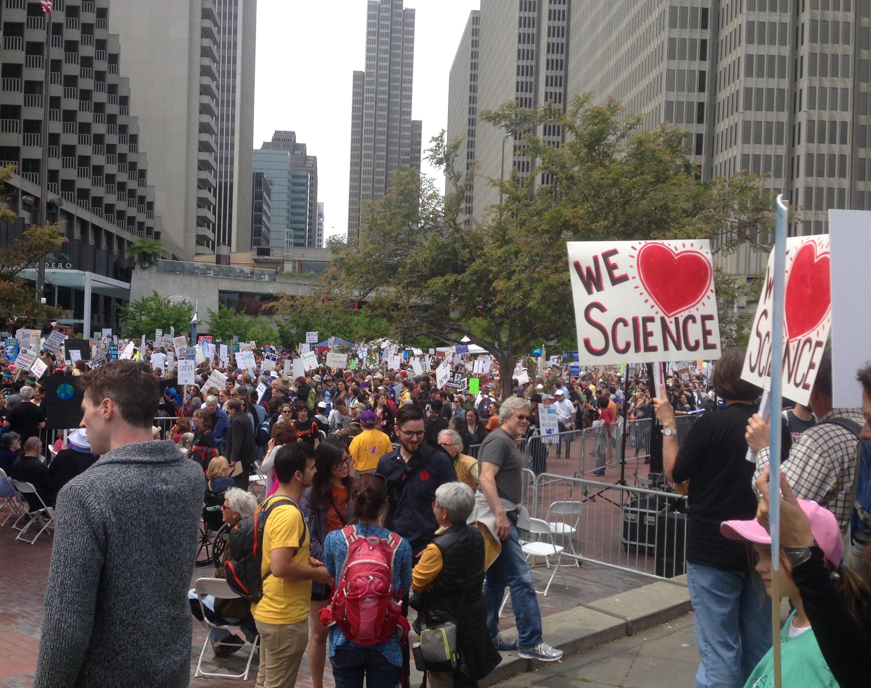
“The Climate Change Crisis:
Healthcare’s Energy & Climate Solutions”
Todd L Sack, MD FACP
Editor, www.MyGreenDoctor.org
Jacksonville, Florida
tsack8@gmail.com 904-403-6446
“I have no financial interests to disclose.”

Slide 2
New York Times
Page 1
January 16, 2020

Slide 3
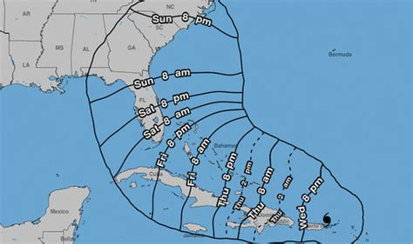
Hurricane Irma, Jacksonville, FL Sept. 2017

Slide 4
Hurricane Irma, Jacksonville, FL Sept. 2017

Slide 5
Hurricane Irma, Jacksonville, FL Sept. 2017

Slide 6
HEALTH
IMPACTS
CLIMATE
CHANGE
Rising Temperatures
Rising sea levels
Extreme Weather:
extreme heat
extreme rainstorms
hurricanes & tornadoes
flooding
droughts & fires
Heat-related deaths
Asthma & heart attacks
Cancers
Emotional illnesses
Infectious diseases: Lyme, Zika, Malaria
Malnutrition & famine
War & climate refugees
Patz, 98
H
HH
Respiratory diseases, e.g.,
Malaria
Dengue
Encephalitis
Hantavirus
Rift Valley Fever
Cholera
Cyclospor
Cryptosporidiosis
Campylobacter
Leptospirosis
Malnutrition
Diarrhea
Toxic Red Tides
Forced Migration
Overcrowding
Infectious diseases
Human Conflicts
Urban heat islnds
Air pollution & Aeroallergens
Vector-borne diseases
Water-borne diseases
Water resources & food supply
Mental Health Stress
Environmental Refugees

Slide 7
Healthcare’s Energy & Climate Solutions
Why is the healthcare industry important?
Are health professionals ready to help?
Our Professional Societies
Our hospitals to the rescue!
Solutions for healthcare offices (and for the rest of us)
Adding climate change to your life.

Slide 9
Healthcare Professionals are Role Models
Gallup survey
December 2017

Slide 10
Are health professionals ready to help?

Slide 11
Survey: Do Health Professionals Believe They Should Lead?

Slide 12
Are Health Professionals Prepared to Lead?

Slide 13
Survey: Resources Requested by Health Professionals

Slide 14
Survey: Do Health Professionals Want Training?

Slide 15
Health Professional Societies with Climate Policies (partial list, 2020)
Alliance of Nurses for a Healthy Environment
American Medical Association
American Academy of Dermatology
American Academy of Family Physicians
American Academy of Pediatrics
American College of Emergency Physicians
American College of Obstetricians & Gynecologists
American College of Physicians
American College of Preventive Medicine
American Psychiatric Association
American Society of General Internal Medicine
American Society of Gynecologic Oncology
British Medical Association
Canadian Medical Association
Infectious Diseases Society of America
Medical Society Consortium on Climate & Health
National Medical Association
World Medical Association

Slide 16
Example: The Medical Society Consortium on Climate & Health
The leading voice for healthcare on climate change in the U.S.
Founded in 2017 by Dr. Mona Sarfaty (George Mason University)
26 Member health professional societies
40 Affiliate health organizations
Represents over 600,000 clinical practitioners

Slide 17
Example: American Medical Association Policies
1989: Global Climate Change - The "Greenhouse Effect"
1989: Stewardship of the Environment
2014: Global Climate Change and Human Health
2016: AMA Advocacy for Environmental Sustainability & Climate
2017: Joined The Medical Society Consortium on Climate & Health
2017: The Health Risks of Hydraulic Fracturing
2018: AMA to Protect Human Health from the Effects of Climate Change
by Ending its Investments in Fossil Fuel Companies
2019: Climate Change Education Across the Medical Education Continuum
Source: https://policysearch.ama-assn.org

Slide 18
AMA: Fossil Fuels Divestment
1. Our AMA, AMA Foundation, and any affiliated corporations will work in a timely, incremental, and fiscally responsible manner, to the extent allowed by their legal and fiduciary duties, to end all financial investments or relationships (divestment) with companies that generate the majority of their income from the exploration for, production of, transportation of, or sale of fossil fuels.
2. Our AMA will choose for its commercial relationships, when fiscally responsible, vendors, suppliers, and corporations that have demonstrated environmental sustainability practices that seek to minimize their fossil fuels consumption.
3. Our AMA will support efforts of physicians and other health professional associations to proceed with divestment, including to create policy analyses, support continuing medical education, and to inform our patients, the public, legislators, and government policy makers.
Source: https://policysearch.ama-assn.org

Slide 19
AMA: Climate Change Education
1. Our AMA supports teaching on climate change in undergraduate, graduate, and continuing medical education such that trainees and practicing physicians acquire a basic knowledge of the science of climate change, can describe the risks that climate change poses to human health, and can counsel patients on how to protect themselves from the health risks posed by climate change.
2. Our AMA will make available a prototype presentation and lecture notes on the intersection of climate change and health for use in undergraduate, graduate, and continuing medical education.
3. Our AMA will communicate this policy to the appropriate accrediting organizations such as the Commission on Osteopathic College Accreditation and the Liaison Committee on Medical Education.
Source: https://policysearch.ama-assn.org

Slide 20
“Our Hospitals to the Rescue!”
Resources for the Greening of Hospitals:
Practice Green Health / Health Care Without Harm
Green Guide to Healthcare (2008)
U.S. Green Building Council
Kaiser’s Center for Total Health
Institute for Healthcare Improvement
American Hospital Association

Slide 21
Example: Health Care Without Harm https://noharm.org
Promoting environmentally responsible healthcare
Hundreds of hospital systems as members worldwide
Initiatives:
Green building & energy use
Medical waste
Toxic materials
Safer chemical choices
Healthier foods in hospitals
Water use
Environmental justice & equity
Pharmaceutical disposal
Green Purchasing
Climate & Health
Transportation options
“CleanMed” in Orlando, May 12-14

Slide 22
Healthcare Offices’ Energy & Environmental Impacts
Millions of healthcare offices worldwide
Offices may cause illness
“inside air is dirtier than outside air”
chemicals, particulates, NO2, fungi
Significant resources are consumed
electricity, water, paper, chemicals
Offices are often high-cost & inefficient
Health professionals are role models
Notes:
Scope: how many doctor offices are there worldwide (I’m researching this)
Environmental impacts: direct: by subject (general)
Impacts: indirect
Unique environmental issues in doctor offices

Slide 23
Solutions for Healthcare Offices: Resources
U.S. E.P.A.’ Energy Star Program: www.energystar.gov
My Green Doctor: www.MyGreenDoctor.org tsack8@gmail.com
Royal College of General Practitioners’ “Green Impact for Health”: www.greenimpact.org.uk/giforhealth
American College of Physicians’ “Climate Change Toolkit” www.acponline.org/advocacy/advocacy-in-action/climate-change-toolkit
American Medical Association: www.mygreendoctor.org/wp-content/uploads/2017/11/AMA-Lower-Costs-by-Going-Green-Practice-Management-PDF-Sack-2017-1.pdf
British Medical Association: www.bma.org.uk/connecting-doctors/search?q=sustainability-health-top-tips
Pediatric Environmental Health Tools Kit: www.psr.org/blog/
resource/pediatric-environmental-health-toolkit

Slide 24
Example: My Green Doctor
A practice management tool for healthcare offices
Free, non-profit provided by the Florida Medical Association
Launched on Earth Day, 2010
Used in more than 540 healthcare offices
In 38 U.S. States, 56 countries
12 health professional societies offer My Green Doctor as a
money-saving membership benefit
Recognized internationally as the leading resource for healthcare
offices
Free to register: www.MyGreenDoctor.org

Slide 25
My Green Doctor
Explains to offices how lower energy use & other wise practices
Suitable for any outpatient office or facility
Most offices will save >$2000 per doctor per year, plus other benefits
Easy to use: adds only five minutes to each office staff meeting
Every meeting is scripted in the Meeting-by-Meeting Guide:
nothing for the office manager to study or prepare
Dozens of free resources for teaching office staff & patients
Evidence & science based, non-political
Can qualify for the Green Doctor Office certificate

Slide 26
My Green Doctor’s Topics
Energy management
Renewable energy
Climate change preparedness
Patient & staff education
Water conservation
Purchasing
Waste management
Chemicals in the office
Transportation choices
Healthy foods

Slide 27
Example: Escambia County Health Dept.
Five patient care sites
Began saving energy the first month
5.2% energy electricity saving per year
125,000 kilowatt hours electricity per year
85,600 metric tons CO₂ per year
Equivalent of 4,349 gallons gasoline
$14,000 being saved annually

Slide 28
Adding Climate Change to Your Life
Save energy: thermostats, lightbulbs, appliances, smaller homes
Use water, chemicals & food wisely. Avoid red meat!
Install solar energy: hot water , photovoltaic (PV)
Buy renewable energy from your utility
Choose an electric vehicle
Reuse & recycle
Travel wisely: buses, bicycles, walking, buy carbon offsets
Divest of fossil fuels industries; invest “green”
Talk about climate change: family, neighbors & leaders.
Vote for climate change action

Slide 29
Healthcare’s Energy & Climate Solutions
Climate change is the #1 threat to human health for the 21st Century.
Hospital systems & healthcare offices are improving their energy use profiles.
Hospital systems & healthcare offices, as role models, can influence public attitudes and behaviors.
Health professional societies are beginning to play important roles to educate their members and direct public policy.
Health professional are willing to help, but need:
Training on the threats to their patients posed by climate change
Knowledge of the programs already available
Educational resources such as brochures, posters, & videos

Slide 30
New York Times
Page 1
January 16, 2020

Slide 31
Healthcare’s Energy & Climate Solutions
Why is the healthcare industry important?
Are health professionals ready to help?
Hospitals to the rescue!
Solutions for medical offices (and for the rest of us)
Adding climate change to your life.

Slide 32
“The Climate Change Crisis:
Healthcare’s Energy & Climate Solutions”
“Thank you!”
Todd L Sack, MD FACP
Editor, www.MyGreenDoctor.org
Jacksonville, Florida
tsack8@gmail.com 904-403-6446

